Slide 1
Getting Started with ASP.Net MVC
Tim Wingfield
Notes:
Preview 2 came out in march.
New preview code drop came out on Thursday (4/17)

Slide 2

Notes:
About me
Live in Hilliard, OH
Wife, two boys, and a black lab

Slide 3

Notes:
Love hockey, especially this guy…pay a lot to see him, at least.

Slide 4



Notes:
Professionally, I work for Quick Solutions, even though none of these people do.
Been with Quick for four years, all in the App Dev Group started by BHP.
Been developing for over 10 years, all in Columbus.

Slide 5
Model
View
Controller
Notes:
Obligatory 3 circle diagram
Smalltalk 1979
Separation of concerns

Slide 6

Notes:
Controller runs the show
It handles the request
Determines view
Determines data to load the view

Slide 7

Notes:
The view is only the presentation to the user
Any logic should only be presentation logic (check boxes checked, dropdowns set, etc)
asp.net version, view can be strongly typed to the model

Slide 8

Notes:
Model returns information as requested, doesn’t know to what view or what controller has called
Model everything that’s not view and controller – business logic, data, not just the db
Speaking point:
You’re thinking, “OK, great. So what? Why now?”

Slide 9




Slide 10



Notes:
PHP lists 35 different MVC implementations on Wikipedia

Slide 11



Notes:
Spring MVC, specifically

Slide 12



Slide 13

Notes:
Demand from community for an offering from Microsoft
Explain why monorail is a valid alternative, but it’s Open Source

Slide 14


!=
Notes:
“What are we trying to solve? What’s wrong with WebForms?”
WebForms tried to move WinForms to web development
Some developers think this is the way the whole web works
Introduced page event model

Slide 15
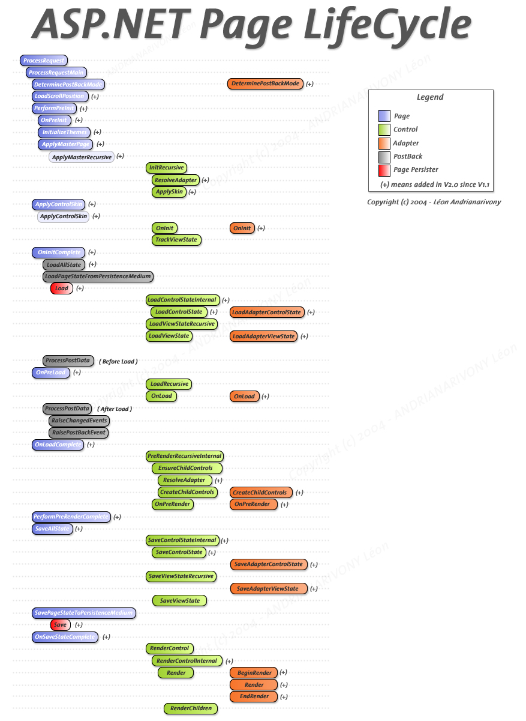
Notes:
Who doesn’t love this?
Was that OnPreInit or OnPreLoad?
Page Lifecycle brings state to the web, not totally a bad thing, but we all know the web is stateless
Runat=server
AJAX comes along, more client interaction
Naming Container in javascript <% %> all over the place
Atlas adds update panel, whole new set of problems

Slide 16

Page_Load(object sender, EventArgs e) { }
Notes:
The spaghetti of the page_load. (A steaming pile of Page_Load)
Neal Ford: “Bad developer will move heaven and Earth to do the wrong thing.”
Mix of presentation and logic in the code behind, no Separation of Concerns
Extremely difficult to test code behinds
Dependent on web server to run
Concrete classes on the web server run WebForms
No way to fake or mock those classes
Speaking Point: “So

Slide 17

Notes:
New offering from Microsoft
Shared source project (similar to the AJAX Toolkit, which is the first I remember)
Expand on not a replacement to WebForms
- Alternative to WebForms
- WebForms not going away
- Not WebForms 4.0

Slide 18

Notes:
Encourage use of OOP principles
Separation of Concerns
Single Responsibilty
Dependencies are abstracted out to HttpContextBase, HttpRequestBase, etc
All Http classes now easily mocked

Slide 19

Notes:
More control over your HTML
Bye bye naming container
Runat=server no longer needed
Separation of concerns, keep business logic out of your presentation code
Use of CSS easier
Notice return of “Classic ASP” type code

Slide 20

Notes:
Routing
Maps incoming URLs to the correct Controllers
Maps outgoing URLs so they can be called back
Originally part of mvc namespace, has been moved “up” to web namespace
RESTFUL – uses get and post out of the box (Adam Tybor’s blog post)

Slide 21
<code />
Notes:
What do you get out of the box?
Working Sample App
Default Routing
Home Controller
Home and About Views
WebFormsViewEngine
Test Project

Slide 22

Request
Response
Notes:
Back to Requset and Response
Request comes in
Controller interprets the request and decides what to do
Application does something cool
Response is sent back to the Internets
No Postback
Page lifecycle still happens (look at trace)
Still based on asp.net

Slide 23
You have options
<a href=“/Product/View/12”>
View Product
</a>
<%= Html.ActionLink(“View Product”,
“View”,
new { id=12} ) %>
<%= Html.ActionLink<Product>
(c => c.View(12), “View Product”) %>
Notes:
Quick and dirty, plain old html. Id replaced by classic asp-ish code
Will work, but magic strings everywhere
If your controller changes, refactoring here will be uncovered at runtime
Better way, as controller is implied. (Unless needed to move to a different controller)
Controller changes will again be uncovered at runtime.
Best way, the view is strongly typed to the controller.
Controller change here will break the build…woo-hoo! Fail early!

Slide 24
MvcContrib.org
IoC container controller factories
View Helpers
Code Snippets and Live Templates
Notes:
Open source project on CodePlex
Adding code for MVC to work with Castle, Spring.Net, Structure Map, etc.
Original HtmlHelpers folded into release 2, MvcContrib picking up where they left off
Add on code for VS and for R#

Slide 25

Web Forms are Dead!
Long Live Web Forms!
Notes:
Still going to fit larger, data driven sites better. (At least for now.)
Much more mature framework to build ASP.Net apps on
Quicker deployment, more drag and drop
More Better UI controls available.
Lots of 3rd party controls available…like our Friends at Telerik
Better Documentation
More examples and code samples to draw from
And, of course, the update panel!

Slide 26
<code />
Notes:
New app
Demo app

Slide 27
Resources
www.asp.net/mvc/
www.hanselman.com/blog/
www.haacked.com
sessions.visitmix.com/?selectedSearch=T22
weblogs.asp.net/scottgu/

Slide 28
Tim Wingfield email: tim@timwingfield.com blog: blog.timwingfield.com twitter: timwingfield

